Slide 1
Project 2
Section 1 - Problem 3
Section 2 - Problem 1
Section 3 - Problem 1
Group 8 – Java:
Peter Boukhalil
Luong Dang
Kimberly Nivon
Julia Beatriz Ramos
Nhi Vu
Notes:
Kimberly

Slide 2
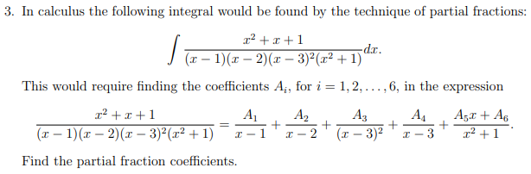
Section 1 - Problem 3
Notes:
Nhi

Slide 3
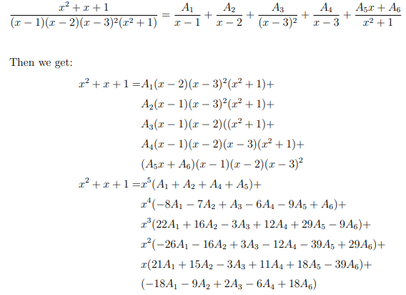
Section 1 - Problem 3 - Finding Matrix A
Notes:
Nhi

Slide 4
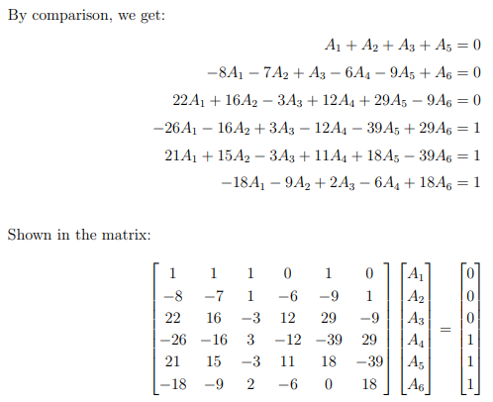
Section 1 - Problem 3 - Finding Matrix A
Notes:
Nhi

Slide 5
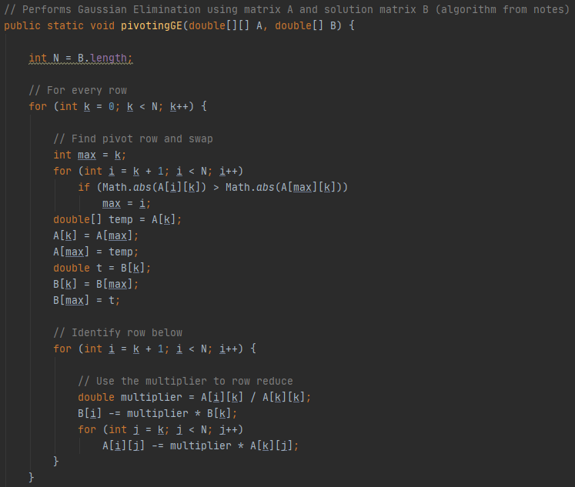
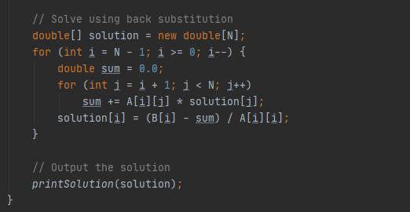
Section 1 - Problem 3 GE Implementation
Notes:
Julia

Slide 6
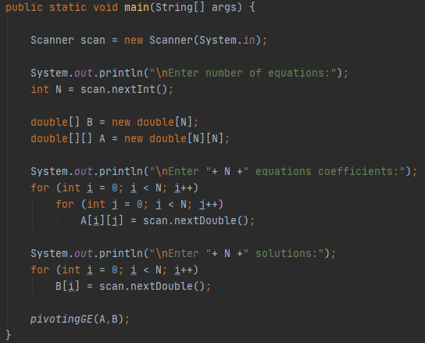
Section 1 - Problem 3 Main Method
Notes:
Julia

Slide 7
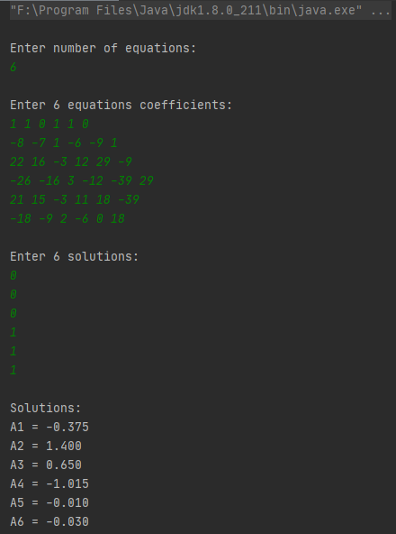
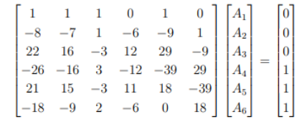
Section 1 - Problem 3
Output
Notes:
Julia

Slide 8
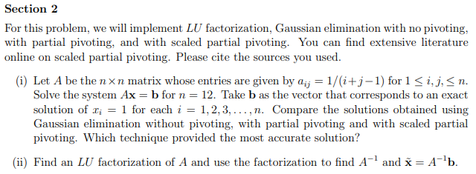
Section 2
Notes:
Nhi, Luong/Julia

Slide 9
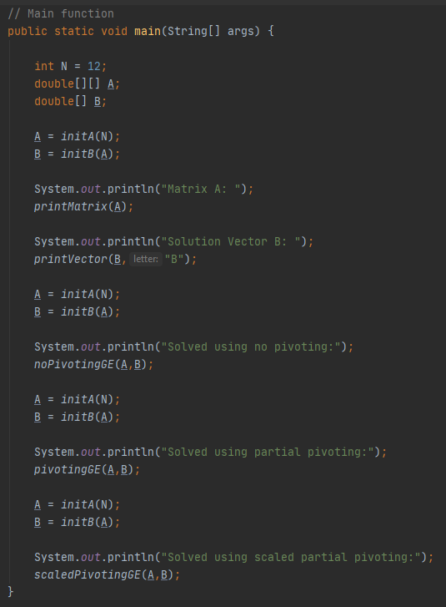
Section 2 - Part (i)
Main Method
Notes:
Nhi

Slide 10
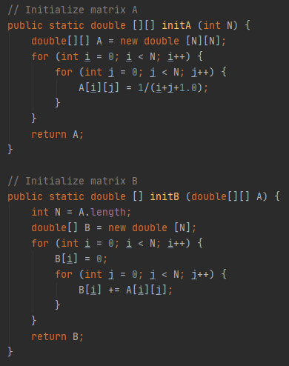
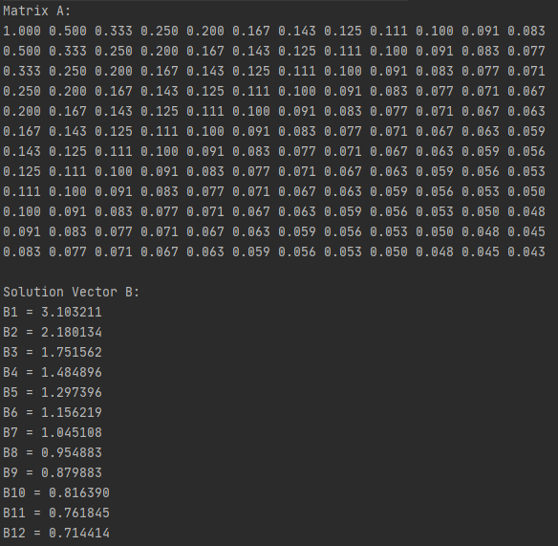
Section 2 - Part (i) - Finding A and b
Notes:
Nhi

Slide 11
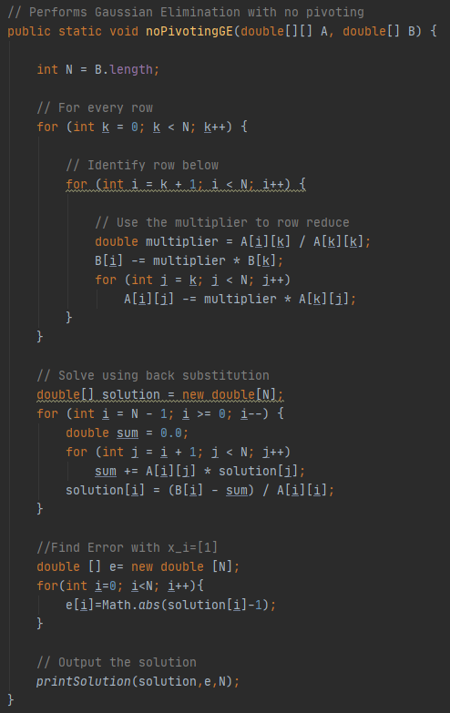
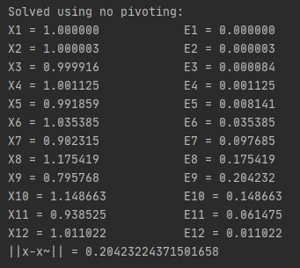
Section 2 - Part (i)
No Pivoting + Output
Notes:
Julia

Slide 12
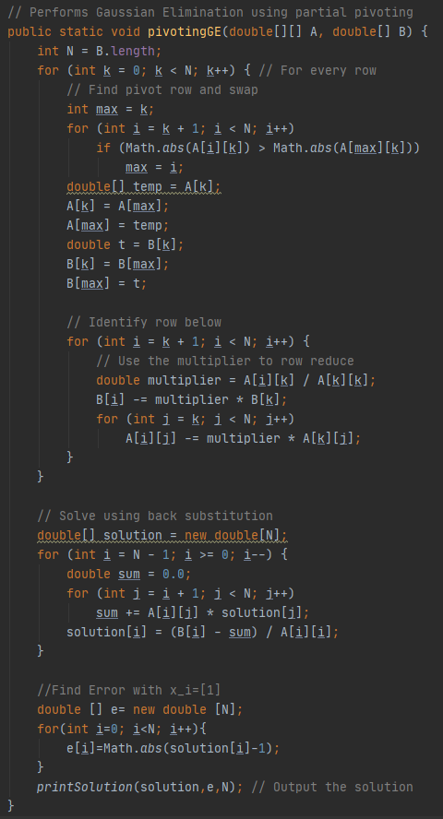
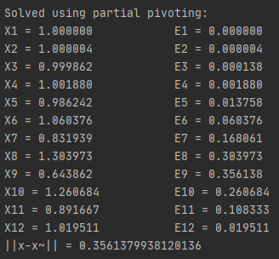
Section 2 - Part (i)
Partial Pivoting + Output
Notes:
Julia

Slide 13
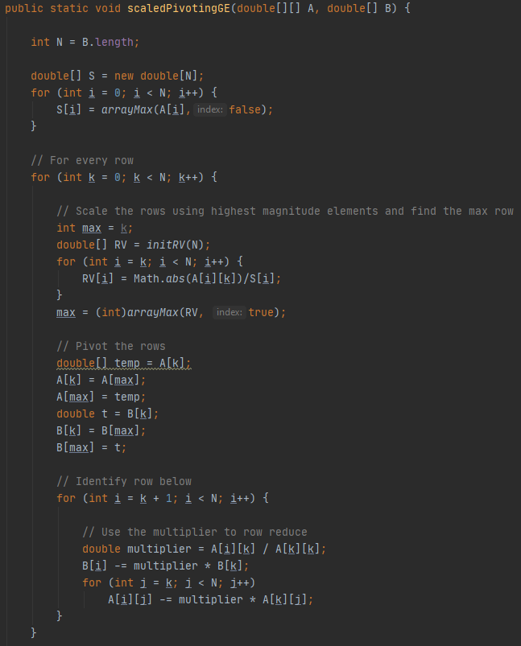
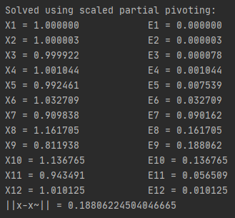
Section 2 - Part (i) Scaled
Partial Pivoting + Output
Algorithm from: https://www.youtube.com/watch?v=4YzIfcSFVCU&ab_channel=ThomasBingham
*Back substitution and print output*
Notes:
Julia

Slide 14
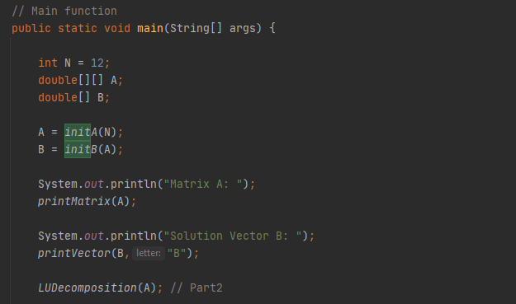
Section 2 - Part (ii)
Reused methods from Part 1:
initA() , initB()
printMatrix()
printVector()
Gaussian elimination algorithm
New methods:
multiplyMatrices()
multiplyMatrixWithVector()
findInverseLowerTri()
findInverseUpperTri()
Notes:
Luong

Slide 15
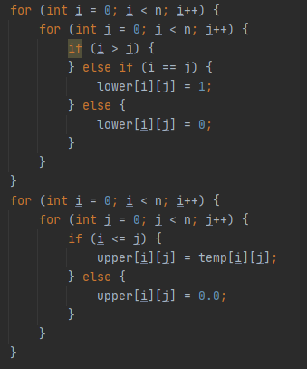
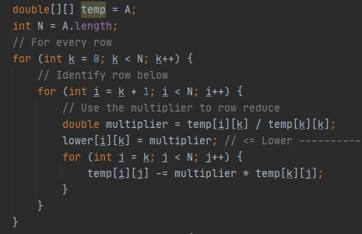
Find L and U matrices
Reused Gauss Elimination Algorithm with modification
a)Upper Matrix = row reduced matrix of A
b)Lower Matrix = multipliers from the Gauss Elimination Operation
Easier to load data into each matrix separately, so we create a temporary matrix, which equals to matrix A. Then have a for-loop to copy tempMatrix’s data into upperMatrix after the elimination.

Slide 16
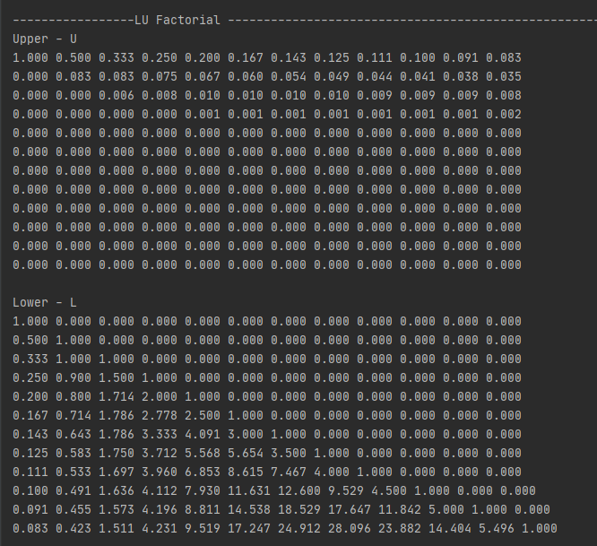
L and U matrix

Slide 17
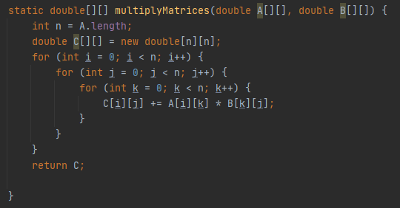
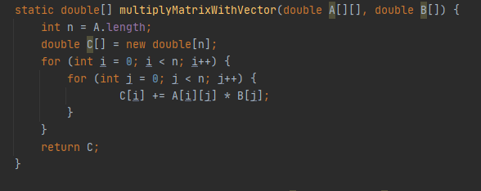
Find Inverse of Matrix A:
Assumption:
A x= LUx = B
=> A= LU
=> A^-1= U^-1 * L^-1
X = A^-1 * B

Slide 18
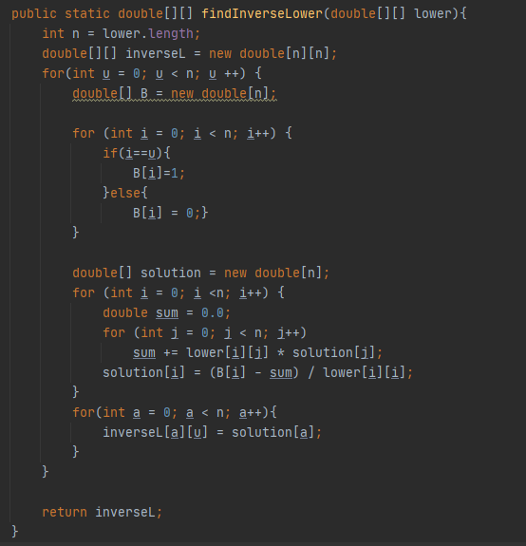

To find Inverse of a matrix, reuse back substitution algorithm with modification
Inverse of a matrix is the solution of Back-substitution
Operation where B is Identity and B = {b1, b2, b3, ..bn}
Ex: bbb = I|a1^-1
bbb = I|a2 ^-1
bbb = I|a3 ^-1
A^-1 = {a1 ^-1,a2 ^-1,a3 ^-1}

Slide 19
L and U matrix

Slide 20
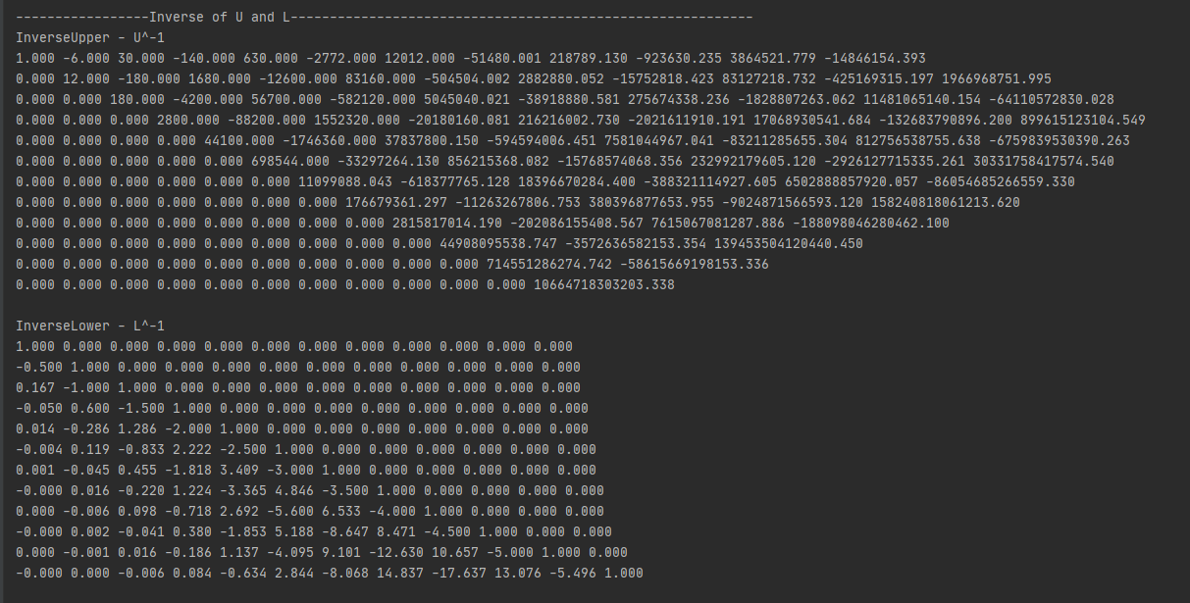
Inverse of L and U matrix

Slide 21
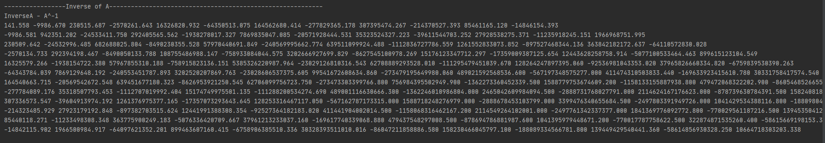
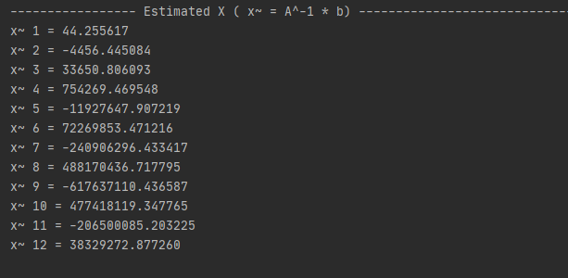
Inverse of A
Estimated X, where x~ = A^-1 * b

Slide 22
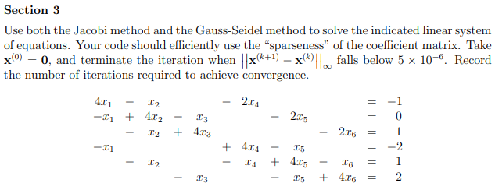
Section 3
Notes:
Peter

Slide 23
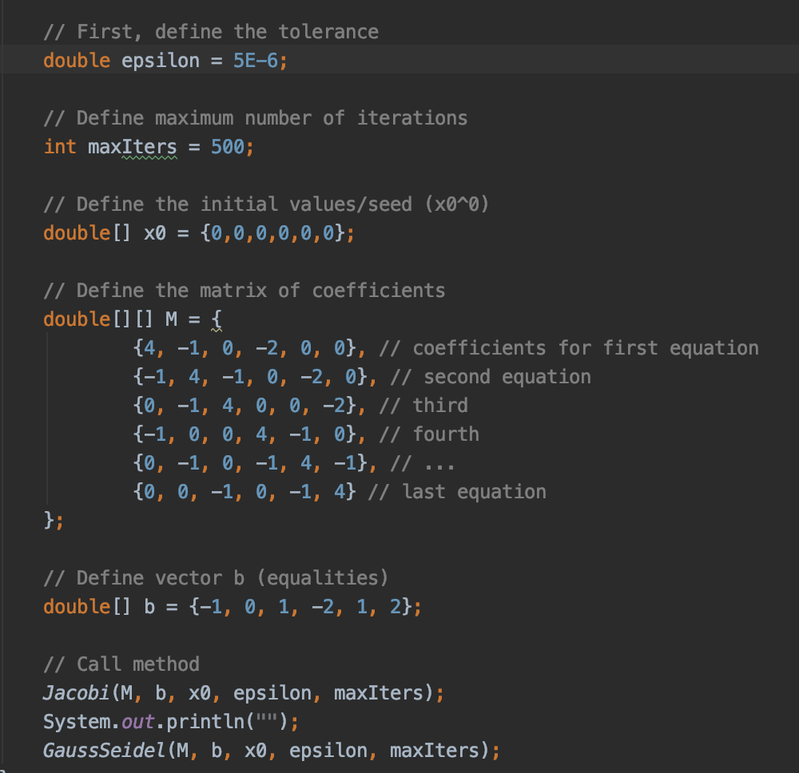
Notes:
Kim

Slide 24
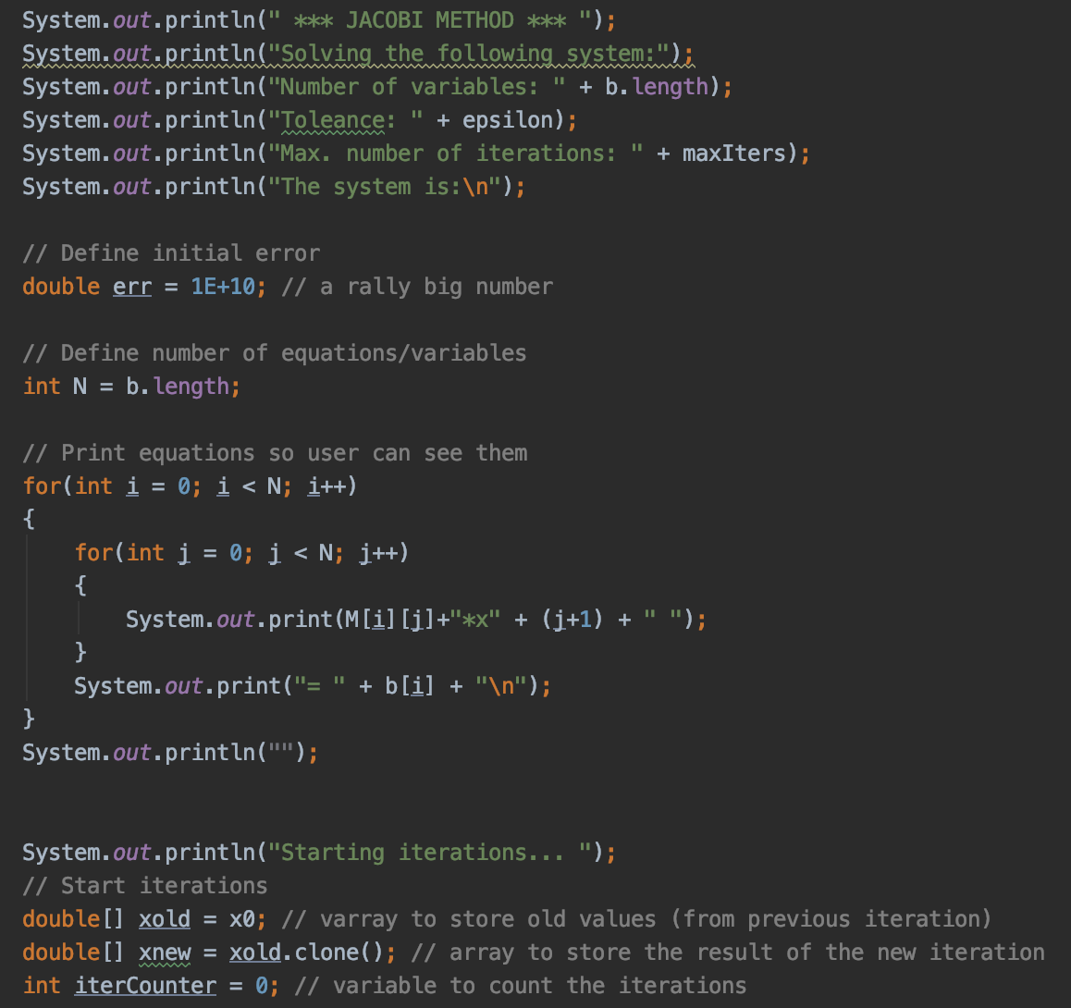
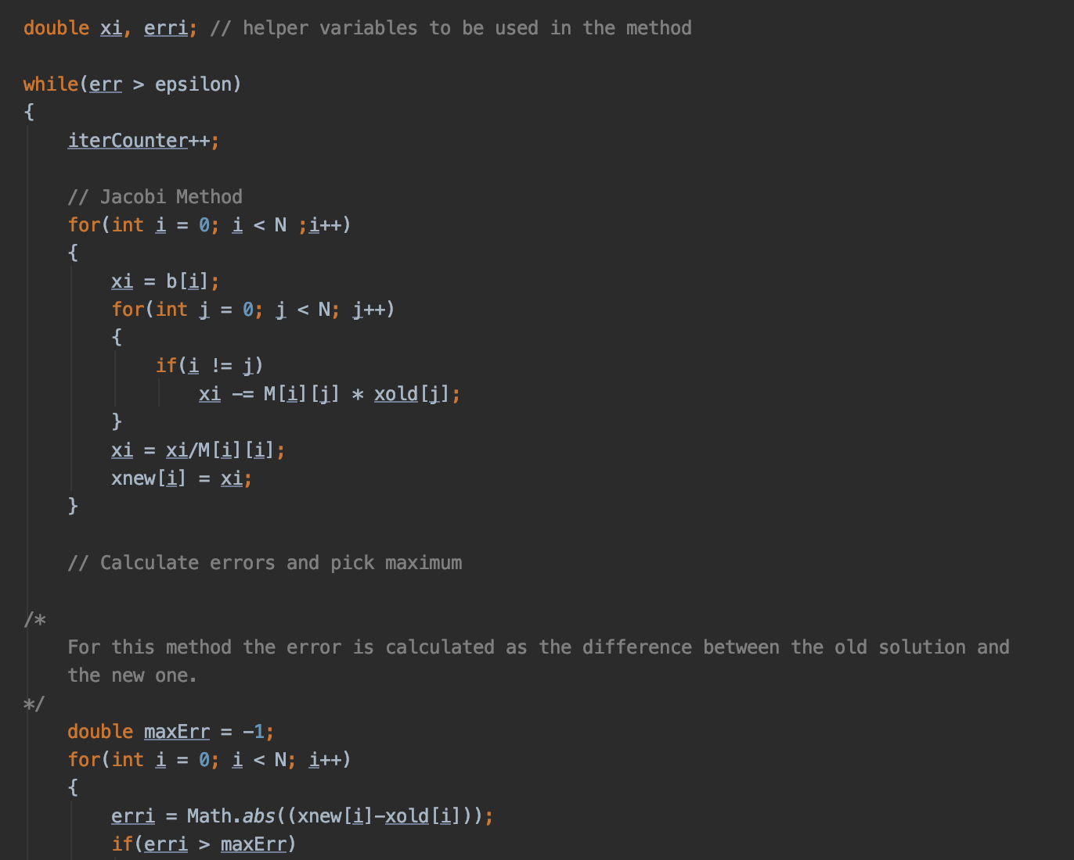
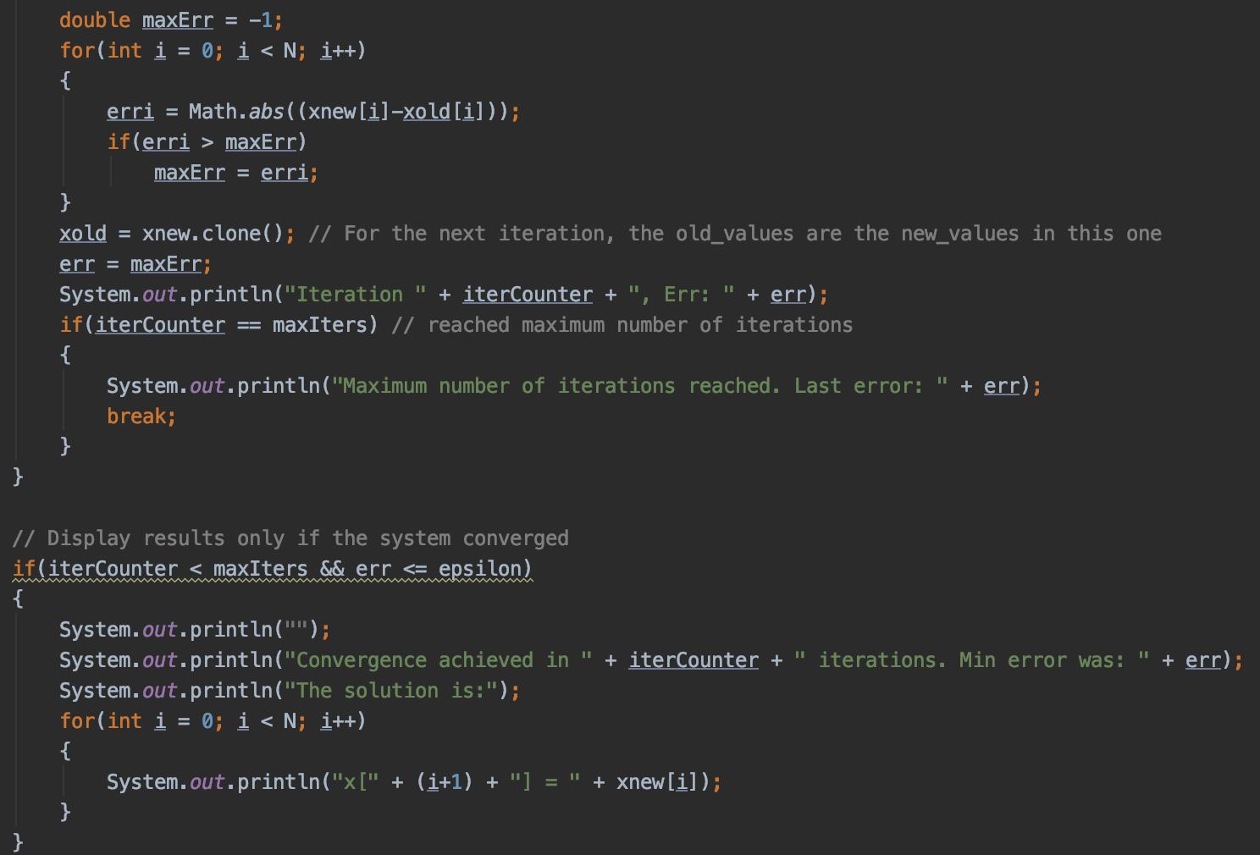
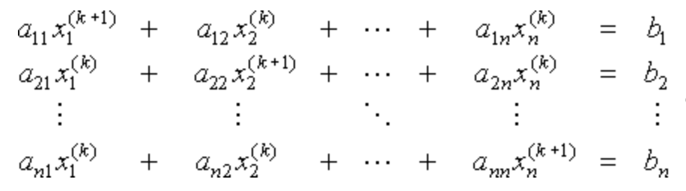
Jacobi Method
Approximation of x^{(k)} = (x₁^{(k)}, x₂^{(k)}, x₃^{(k)}, …, x_{n}^{(k)}) to find new values: x^{(k+1)} = (x₁^{(k+1)}, x₂^{(k+1)}, …, x_{n}^{(k+1)})
Starts with x (0) = 0
Use old values to calculate the new value within equation
We then calculate the absolute error
Iteration occurs to find a sequence of increasingly better approximation
Notes:
Kim

Slide 25
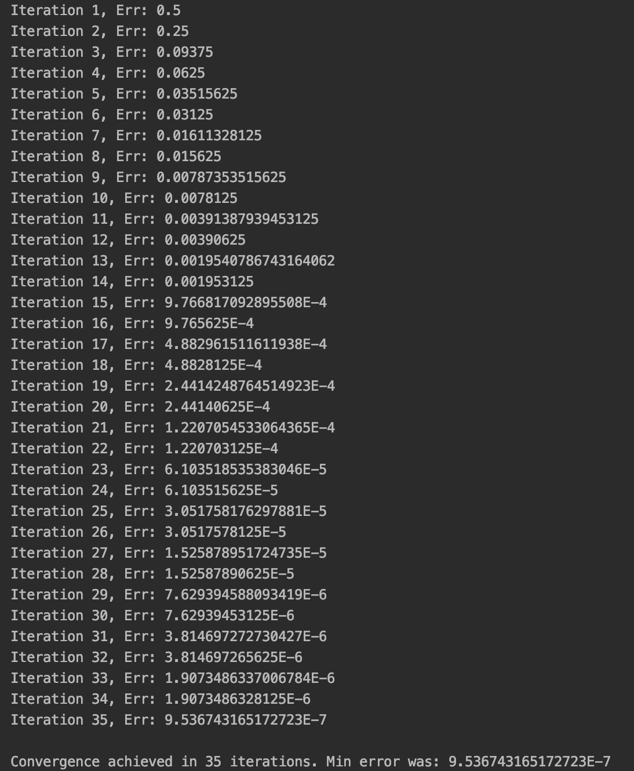
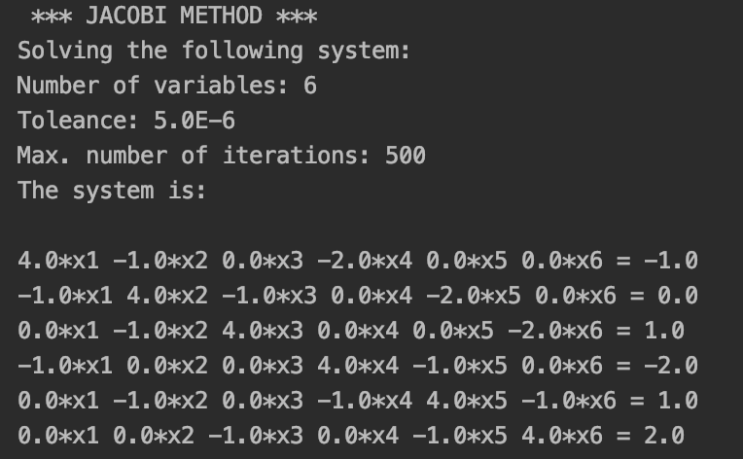
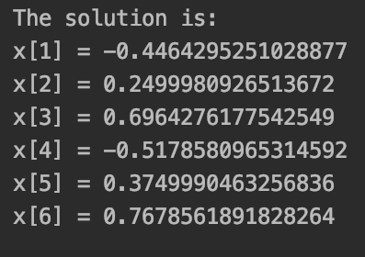
Jacobi Method - Output
The new values are:
35 Iterations required to achieve convergence
Notes:
Kim

Slide 26
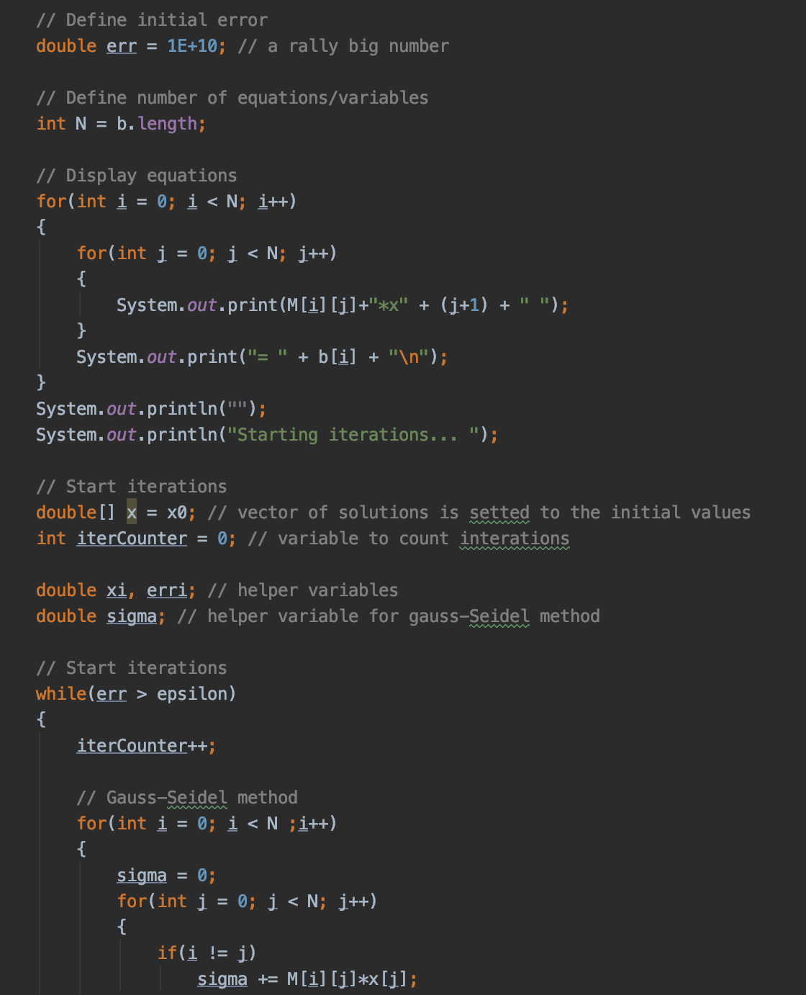
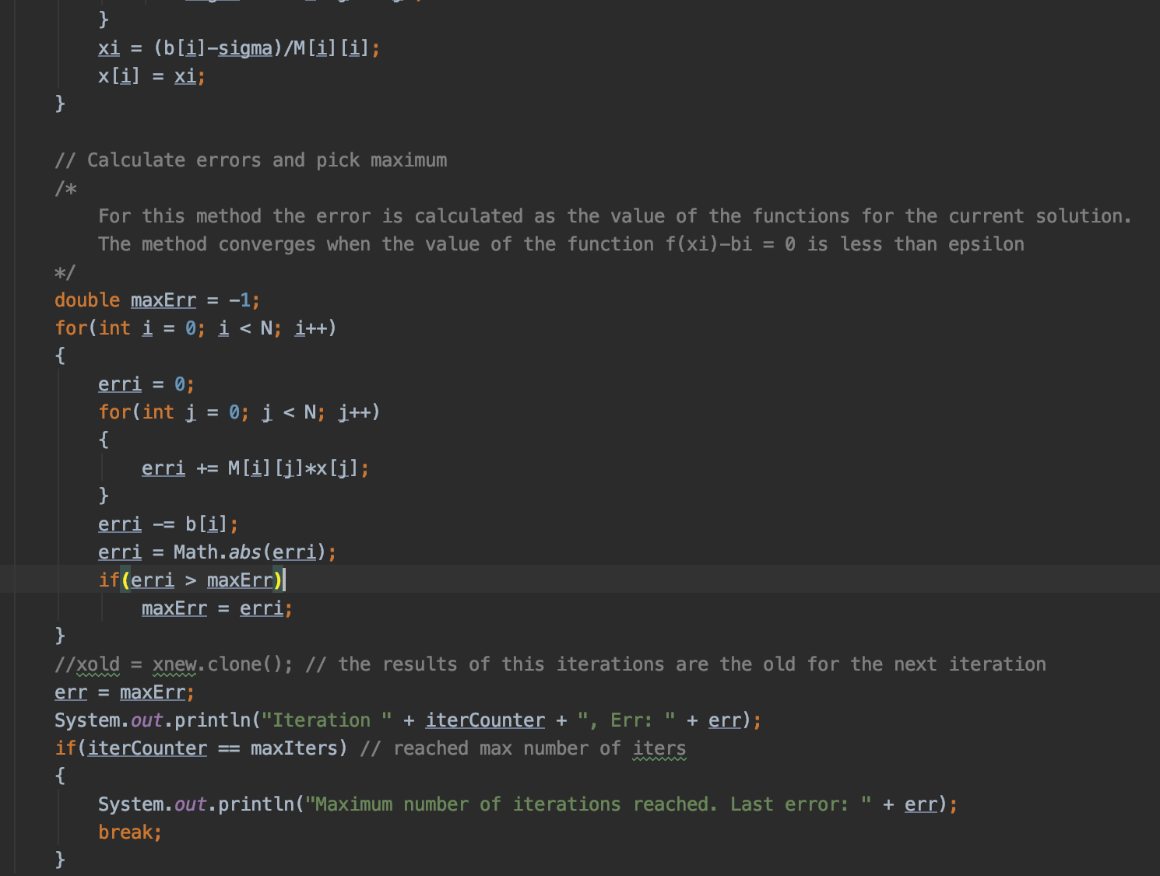
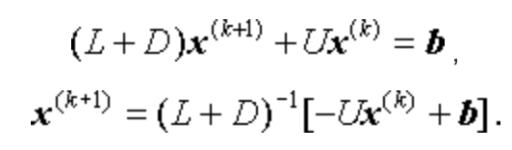
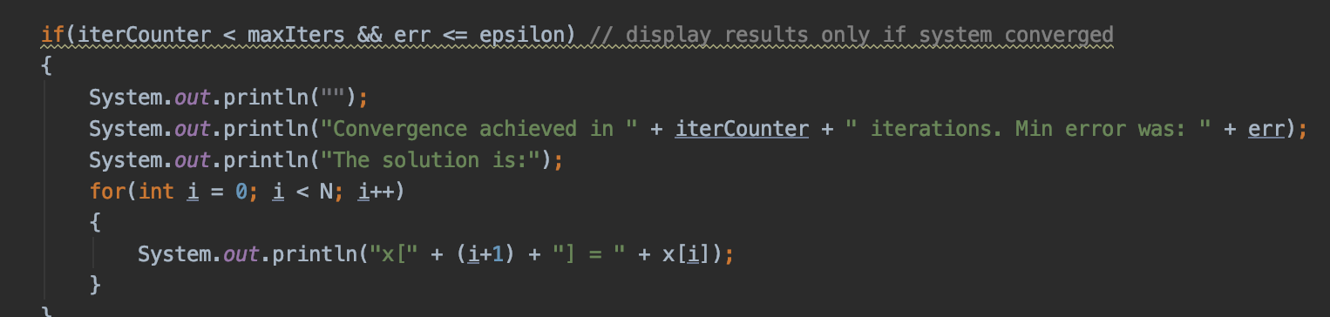
Gauss-Seidel Method
Where true solution is x = (x₁, x₂, … , x_{n})
That is..
Similar to Jacobi Method except we solve this using the new and old values to get the new value
Notes:
Solution is found when x = (x1, x2, … , xn), if x1(k+1) is a more suitable approximation to x1 than x1(k). Then we would proceed to find the new value x1(k+1) to use instead of an old value
Peter

Slide 27
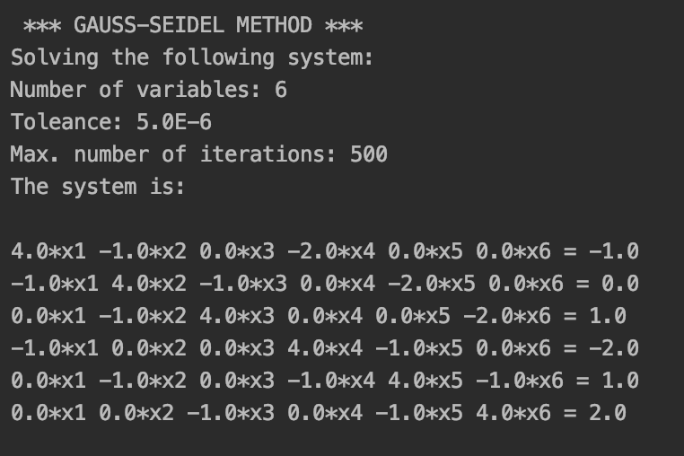
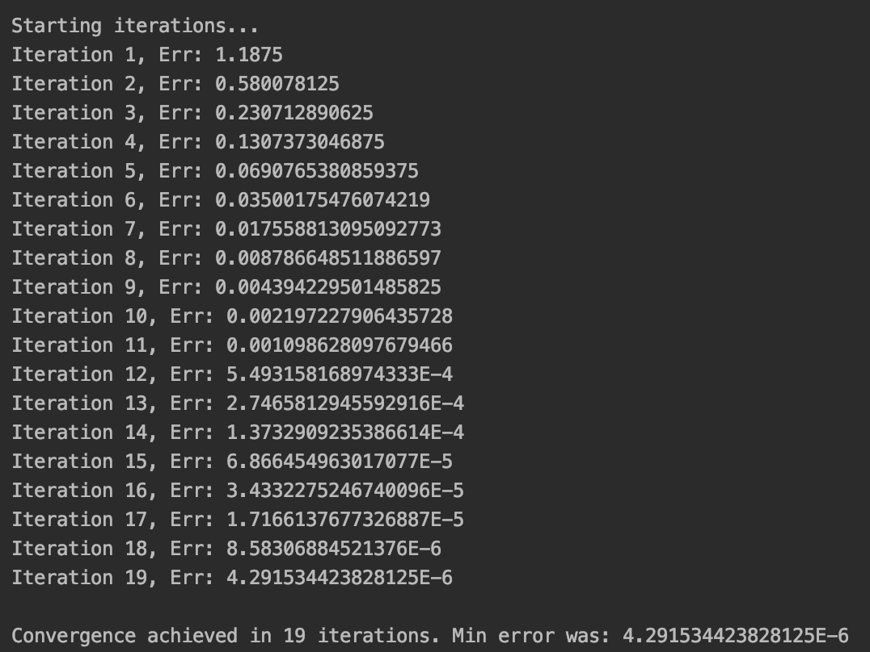
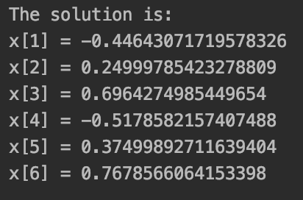
Gauss-Seidel Method- Output
The new values are:
19 Iterations required to achieve convergence
Notes:
Peter

Slide 28
The End

